Slide 1


Ruhsal Güzellik
SÖZ’E BAĞLILIK
Böyle Zamanlarda
Dorothy Watts
Genel Konferans
Kadın Hizmetleri Departmanı
Notes:
Giriş
Beş yaşındaki Billy, karmaşık bir sorun hakkında tartışan annesini ve babasını dinliyordu. «Şimdi ne yapacağız?» diye içini çekti annesi.
«Bilmiyorum» dedi babası, başını iki yana sallayarak, alnında endişeli çizgiler vardı. «Yardım için başka kime başvururuz, onu da bilmiyorum."
«Yardım için neden Kutsal’a sormuyorsun?» diye sordu Billy.
«Kutsal mı?" diye tekrarladı babası. «Kutsal kim? Ben o isimde birini tanımıyorum.»
Billy «Biliyorsun tabii» dedi. «Göklerdeki Babamız, adın kutsal kılınsın.»
Çoğu zaman tıpkı Billy’nin annesi ve babası gibi endişelerle, üzüntülerle, sıkıntılarla yüzleştiğimizde, nereye gideceğimizi bilmediğimizde ihtiyaç duyulan tek şey «Kutsal’a danışmaktır.» İhtiyacım olan tek şey her zaman güvenebileceğimiz biri olan İsa Mesih’e, canlı Söz’e, onun yazılı Söz’üne yani Kutsal Kitap’a dönmektir.

Slide 2


SÖZ’E BAĞLI KALABİLİRİZ
Bugün “depend” yani bağlılık sözcüğünün harflerini akrostiş olarak alarak, Söz’e bağlı olmayı gerektiren yaşamımızın bazı alanlarından bahsedeceğiz.
Notes:
Söz’e bağlı kalabiliriz!
Bugün “depend” yani bağlılık sözcüğünün harflerini akrostiş olarak alarak, Söz’e bağlı olmayı gerektiren yaşamımızın bazı alanlarından bahsedeceğiz.

Slide 3
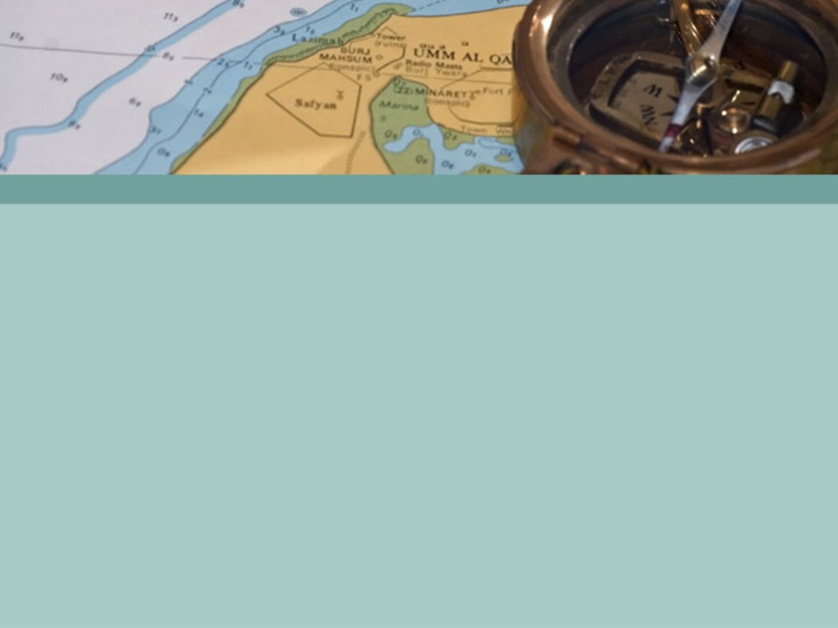
D – DIRECTION (YÖN)
Mezmur 119:105
Notes:
D – Direction (Yön): Mezmur 119:105 (Birisi okusun). (NEXT SLIDE)
Yaşamıma yön vermesi için Söz’e bağlı kalmak konusunda sizlere kendi yaşamımdan bir öykü anlatayım. (Kendi hikayenizi anlatın veya veren hikayesi paylaşın).
It happened when Ron and Dorothy Watts were missionaries in India. They had come home for three months to visit relatives and try to find a baby to adopt. It was now mid-August and they were scheduled to go back the first week of September. Ron was filling speaking appointments in California while Dorothy visited her mother in Ohio.
Ron phoned one evening to tell Dorothy that newborn twin boys were available for adoption. They could have them, but they would have to take up residence in California for one year to complete the adoption proceedings. Ron asked her to join him in prayer for one day to find out God's will for them in this matter.
Dorothy prayed long that night, but no answer came. She prayed again the next morning, but there was no answer.

Slide 4
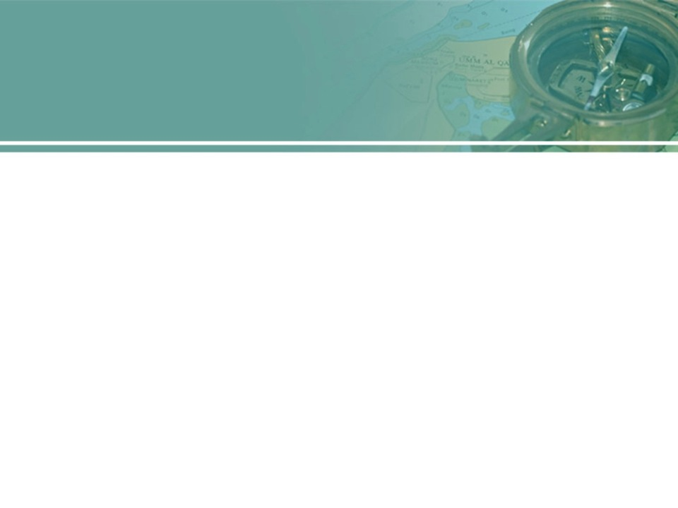
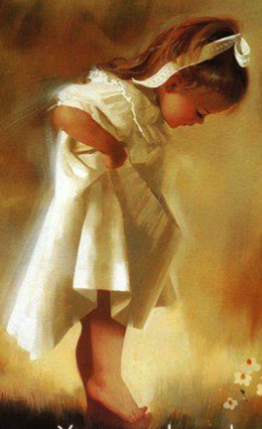
D- DIRECTION (YÖN)
Sözün adımlarım için çıra, yolum için ışıktır.
Mezmur 119:105

Slide 5


Dua Etmenin ABC'si
Yazar: Glenn Coon
Notes:
Then the mailman came with several books that she had ordered on the ABC's of Bible Prayer by Glenn Coon. She opened them and discovered how to claim the promises and know for sure her prayer was answered. It was as easy as ABC.

Slide 6

A – ASK (DİLEYİN)
”Dileyin, size verilecek; arayın, bulacaksınız; kapıyı çalın, size açılacaktır."
Kutsal Kitap’ta senin ihtiyaçlarına hitap eden 3.573 vaatten birini bul.
Notes:
A – ASK (Dileyin). ”Dileyin, size verilecek; arayın, bulacaksınız; kapıyı çalın, size açılacaktır."
Kutsal Kitap’ta senin ihtiyaçlarına hitap eden 3.573 vaatten birini bul.

Slide 7

B – BELIEVE (İNAN)
"İmanla dua ederseniz, dilediğiniz her şeyi alırsınız." O’nunla herşeyin mümkün olduğuna ve O’nun vaat ettiği şeyi yapacağına inanın.
Notes:
B – BELIEVE (İnan). "İmanla dua ederseniz, dilediğiniz her şeyi alırsınız.« Allah’ın sözüne sadık kaldığına inanın. O’nun güvenilir olduğuna, yalan söylemeyeceğine inanın. O’nunla herşeyin mümkün olduğuna ve O’nun vaat ettiği şeyi yapacağına inanın.

Slide 8
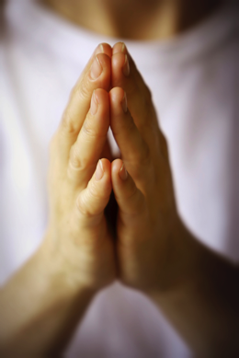
C – CLAIM (ISRAR ET).
Vaade sahip olmak için ısrar et.
Vaadi öğrenmek için Kutsal Kitap ile diz çök.
Ayetlerin üzerine parmağını koy ve Allah’a geri oku.
Notes:
C – CLAIM (Israr et). Vaade sahip olmak için ısrar et. Vaadi öğrenmek için Kutsal Kitap ile diz çök. Ayetlerin üzerine parmağını koy ve Allah’a geri oku. Şöyle söyle: «Rabbim, Sen söyledin ve ben de inanıyorum. Şimdi bu vaade ve vaat ettiğin şeyi yapacağına güveniyorum. Şimdi bunu yaptığın için Sana teşekkür ediyorum. Yapmayı vaat ettiğin şeyi zaten şu an yaptığına inanıyorum. Teşekkürler!
Now all Dorothy needed was to find one of those 3,573 promises that said, "The Watts shall adopt twin boys from California." It was not there.
But she did find one in James 1:5 that said, "If any man lack wisdom, let him ask of God, that giveth to all men liberally, and upbraideth not, and it shall be given him."
She knelt and, placing her finger on the promise, she prayed: "Dear God, you have promised here to give me wisdom if I will only ask. I'm asking. Please give me wisdom about Your will concerning this adoption. Shall we stay for a year to adopt them, or shall we forget it and return to India immediately?"
At that moment the word "car" popped into her head and she thought of the car they had been using for three months. If they were going back to India, they needed to sell it quickly. If they were staying for a year, they would need the car. They had tried to sell the car before Ron left for California, but no one had answered their advertisement.

Slide 9
Notes:
Maybe that is why it did not sell! Dorothy thought. Of course! God knew about this adoption and that we'd have to stay and we would need a car! "Lord, is this the answer?" she prayed. "Is this what You have in mind for us? Should we keep the car and adopt the babies?"
She was still on her knees when the phone rang. She answered it and a lady said, "Do you have a car for sale?"
Dorothy was amazed. This was incredible. The car wasn't even advertised! How did she know?
"Yes, but it is not in very good condition," Dorothy replied. "You might not want to buy it. I think there's something wrong with the clutch, and the carburetor, and the starter, and maybe the brakes. I'm not sure what all." You can see how she wanted things to turn out!
"My dad is a mechanic," the caller replied. "May we come over and look at it now?"
Within 15 minutes they were there. They drove the car around the block. He looked under the hood and checked this and that. "Nothing much wrong I can't fix," he said. "How much do you want for it?"
The Watts had bought the car for $850. Ron said they would be lucky to get $600 for it, but that they would just have to take anything they could get. Dorothy did not want that car to sell. Although they had paid only $850 for it, she said, "$925."
"We'll take it," the man said. They wrote a check on the spot. The car was gone and Dorothy had no doubt about what they should do. They returned to India where the Lord gave them three beautiful Indian children, now grown, and five grandchildren.

Slide 10

E - EMOTIONAL (DUYGUSAL) İHTİYAÇLAR
Filipililer 4:19
Notes:
E - Emotional Needs: Philippians 4:19 (Have someone read it). (NEXT SLIDE)
Minirth ve Meier 12 temel ihtiyaçlar sıraladılar. Hava, yemek, su, zihinsel uyarılma, seks, sevgi, öz değeri, güç, kendine güven, konfor, güvenlik ve ruhsal gerilimden rahatlık. İlk üçü hayatta kalmak için fiziksel ihtiyaçlardır. Diğerleri zihinsel veya duygusal ihtiyaçlar.
Tanrı bütün bu ihtiyaçların, hem duygusal hem fiziksel, yerine getirmek ister. Burada senin israr edebileceğin bir vaat var.
Tanrım da her ihtiyacınızı karşılayacaktır. Duygusal ihtiyacını sağlamak için Sözüne güvenebilirsin.
(Tanrı senin bir arkadaş, konfor, gücü ya da diğer herhangi bir duygusal ihtiyacı sağladığı kişisel bir deneyim paylaşın. Ya da aşağıdaki hikayeyi kullanabilirsiniz).
Soon after Dorothy Watts moved from Oregon to Michigan, she was alone for a weekend. On Friday evening, she sat at the piano playing old familiar hymns. When she came to, "I Want My Friends to Pray for Me," tears filled her eyes, and she couldn't see to play through to the end of the piece.
"Oh, God,” she sobbed. "I don't have even one friend in this new place to pray for me. Please, Lord, I need a friend! I'm so lonely!"
The next day, she opened the mailbox to find a card from Muriel, a woman at a nearby church where Dorothy's husband had preached. They had shared lunch and the afternoon with her family. The card said, "I feel impressed to write you a note and let you know that I am praying for you. I would like to be your friend."
God supplied Dorothy's emotional need for a friend. And you can depend on Him to supply all your emotional needs as well.
Joni Earekson Tada is another example of someone who found that God met her emotional needs. She has been a quadriplegic since the age of 17 due to a diving accident. Life has been difficult for Joni, as she has to be totally dependent on others. However, through this she has learned to totally depend on God and His Word for her emotional needs.

Slide 11


Tanrım da her ihtiyacınızı kendi zenginliğiyle Mesih İsa'da görkemli bir biçimde karşılayacaktır.
Filipililer 4:19

Slide 12
"Tanrı’ya umut bağla, Çünkü O’na yine övgüler sunacağım; O benim kurtarıcım ve Tanrım’dır.”
Mezmur 42:5
Notes:
She writes, "This morning I knocked over a huge pile of dictation with my wheelchair and I felt so clumsy. I just felt so handicapped. At times like that when a wave of emotion threatens to swallow me, I've trained myself to hold on to some objective anchors from God's Word, like ‘Put your hope in God for I will yet praise Him, my Savior and my God’ (Psalm 42:5). It's especially helpful on those 'Oh, I wish I had my hands, days.'”
Yes, we can depend on God's Word to meet our emotional needs.

Slide 13

P - PHYSICAL (FİZİKSEL) İHTİYAÇLAR
Matta 6:28-33
Notes:
P - Physical Needs: Matthew 6:28-33. (Have someone read it). (NEXT SLIDE)
(Tanrı O'nun sözünü tuttu ve sizin için gıda, giyecek, barınak ve faturaları ödeyecek para ile fiziksel ihtiyacını sağladığı ile ilgili kişisel bir hikaye paylaşın. Veya aşağıdaki hikayeyi paylaş)
Dorothy Watts experienced the truth of this promise when she was a young pastor's wife. She was not working so she had to spend a good deal of time trying to make the budget stretch to cover basic expenses. There was nothing for new clothes.
One morning her husband found her sitting on the bed crying. "What's wrong?" Ron asked.
"I don't have anything to wear that fits me anymore," she cried. She held up a dress for her husband to see. He could tell she had gained weight and there was no way the dress would fit. He laughed. "Well, the Lord has sure looked after us well, hasn't He?"
But Dorothy really did have a problem. She was a pastor's wife and she needed to look decent on Sabbath morning. She prayed, "Dear God, please, I need a new Sabbath dress. I want to look respectable, but I don't have any money. I don't know what to do. This is your problem now, Lord. Help me."
She heard no audible voice, but she did receive a definite impression that she should go downtown and buy a dress.
"But, Lord, I have no money, and Ron and I have agreed that I wouldn't buy things on our charge card," she countered.
"Come on, Dorothy," it seemed God was saying to her. "You leave the money to me."
So she caught the next bus and found herself walking the street looking in shop windows at dresses she had no money to buy. She hadn't walked a full block when she met a friend coming from the opposite direction. "Where are you going?" she asked. "To look for a Sabbath dress," Dorothy replied. "Now isn't that interesting," the friend beamed. "I had just come down to buy you a special gift to thank you for all you have done. Come, let me buy your dress for you!"
You can depend on God's Word to supply your physical needs, even needs as small as vitamin drops.

Slide 14
Giyecek konusunda neden kaygılanıyorsunuz? Kır zambaklarının nasıl büyüdüğüne bakın! Ne çalışırlar, ne de iplik eğirirler. Ama size şunu söyleyeyim, bütün görkemine karşın Süleyman bile bunlardan biri gibi giyinmiş değildi. Bugün var olup yarın ocağa atılacak olan kır otunu böyle giydiren Tanrı'nın sizi de giydireceği çok daha kesin değil mi, ey kıt imanlılar?

Slide 15
Öyleyse, ‘Ne yiyeceğiz?’ ‘Ne içeceğiz?’ ya da ‘Ne giyeceğiz?’ diyerek kaygılanmayın. Uluslar hep bu şeylerin peşinden giderler. Oysa göksel Babanız bütün bunlara gereksinmeniz olduğunu bilir. Siz öncelikle O’nun egemenliğinin ve doğruluğunun ardından gidin, o zaman size bütün bunlar da verilecektir.
Matta 6:28-33.

Slide 16
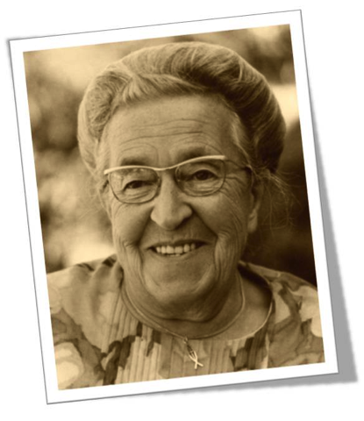

Corrie ten Boom
Notes:
In her book The Hiding Place, Corrie ten Boom tells how she depended on God to supply vitamin drops.
Corrie had smuggled a small bottle of vitamin drops into the prisoner of war camp to help her sister Betsy who was not well. At one point Betsy was desperately ill, and this small bottle of drops was the only medicine Corrie had to help. Of course, many others were sick and needed it just as much as Betsy, but Corrie didn't want to share. However, Betsy insisted. Miraculously, there were always enough drops for those in need, and Betsy always got hers as well.
The bottle was dark and Corrie couldn't see how much was left, but she simply prayed and asked God to let it last as long as it was needed. It seemed to go on and on like the widow's cruse of oil. At last Corrie got a sympathetic guard to get another bottle of vitamins. However, she didn't want to waste any of the first bottle, so she went to finish it up before opening the new one. To her amazement, it was empty. There was not one drop left. God had been faithful in meeting each day’s need.

Slide 17
Tanrımız tüm ihtiyaçlarımızı karşılar… O’nun Söz’üne güven!
Notes:
Rabbim tüm ihtiyaçlarınızı karşılasın. Söz’üne güvenin!

Slide 18
E - ETERNAL (EBEDİ) İHTİYAÇLAR
1. Petrus 2:2.
Notes:
E – Ebedi İhtiyaçlar: 1. Petrus 2:2. (Birisine okumasını söyle). (NEXT SLIDE)

Slide 19
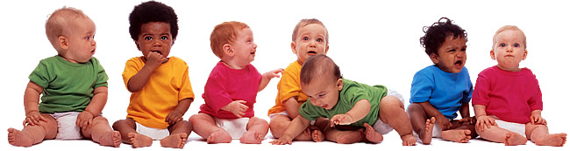
Yeni doğan bebekler gibi saf ruhsal sütü isteyin, öyle ki bununla beslenip büyüyerek kurtuluşa erişesiniz.
1 Petrus 2:2

Slide 20
Rabbin Söz’ü Kurtuluşumuz’un aracısıdır, çünkü bizler yaşayalım diye ölen Canlı Söz’e işaret etmektedir.
Ruhsal olarak gelişmemizi sürdürecek, değiştirecek ve O’nun istediği gibi biri olmamızı sağlayacak olan şeydir.
Notes:
The Word of God is our means of Salvation, for it points to the Living Word who died that we might live. It is what we need to continue to grow spiritually, to change and grow and become what God wants us to be.
Kay James, a US government leader, knows you can depend on the Word for your eternal needs.
She was a senior in high school. Her family was not religious, but she was sitting at the dinner table one night watching a Billy Graham crusade on TV. It was youth night, and Billy Graham was giving a challenge. She listened to what he was saying, then went back to her bedroom and prayed.
"God, Billy Graham says you are there. I don't know if You are or not, but I'm going to give it a shot. I don't like the way my life is going. I have too many problems, and I can't figure them all out, so I'm going to give my life to You. If I don't like what You do with it, I'm going to take it all back, but You've got a year."

Slide 21
Notes:
She searched the house and came up with a King James New Testament and began reading in Matthew. She couldn't understand it, but kept going because she had made a promise. She finished Matthew and started Mark and decided this was the dumbest book she had ever read. It was beginning to repeat itself.
Still, Kay was determined to give it a try and already she sensed that something was happening inside of her that she couldn't quite understand. Looking back, she realizes that the power of the Holy Spirit was in that book. By the time the year was up, she had given her life to God completely. She had accepted His salvation and was growing daily through the reading of the Word.
Petra Sukow was a Nazi youth worker who attended George Vandeman's evangelistic meetings in London. She was an agnostic, but Elder Vandeman challenged her to spend 15 minutes a day with the Word to see for herself what it could do for her life. In her characteristic fashion of wanting always to do her best, Petra began spending not 15 minutes, but an hour a day with the Bible. Of course she found Jesus, believed, was born again, and became a worker for Him.

Slide 22
Söz ile vakit geçirirsen, İsa’yı, kurtuluşu bulabilir ve imanda gelişebilirsin. Ona şans verirsen, yaşamını ebediyen değiştirmen muhakkaktır. Ebedi ihtiyaçların için Söz’e bağlı kalabilirsin.
Notes:
Söz ile vakit geçirirsen, İsa’yı, kurtuluşu bulabilir ve imanda gelişebilirsin. Ona şans verirsen, yaşamını ebediyen değiştirmen muhakkaktır.
Ebedi ihtiyaçların için Söz’e bağlı kalabilirsin.

Slide 23
N – NEED (YAŞAMIN ANLAMI İÇİN İHTİYAÇ)
Mezmur 119:104
Notes:
N - Need for meaning in life: Psalm 119:104. (Let someone read it) (NEXT SLIDE)
Biz şeylerin büyük düzeni bir anlayış vermek için Tanrı'nın Sözünü bağlı kalabiliriz, evren için Tanrı'nın planı, acı ve ıstırabın sebebi, yaşamımız için Tanrı'nın amacı, deneme ve zorluklar bizim için O'nun amacı.

Slide 24
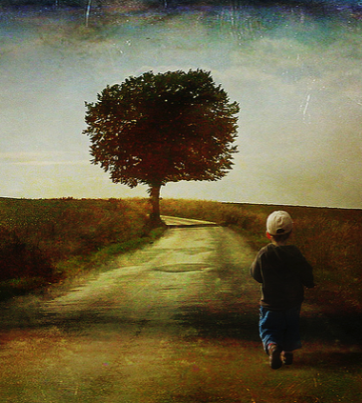
Senin koşullarına uymakla bilgelik kazanıyorum, bu yüzden nefret ediyorum her yanlış yoldan.
Mezmur 119:104

Slide 25
O’nun Söz’ü ile vakit geçirirsek, yaşama dair her türlü çetin sorulara yanıtlar bulabiliriz. Varlığımızın amacını, anlamını ve sonucunu anlayabiliriz. Karşılaştığımız tüm zorluklara ve engellere rağmen bir sebep bulabiliriz. Anlam ve amaç için Allah’ın Söz’üne tutunabilirsin.

Slide 26
8 Aralık 1941’de, yani Pearl Harbor baskınından bir gün sonra Japon bir savaş gemisi, o zamanlar oniki yaşında olan Fay Anderson’un ailesiyle yaşadığı Çin’in Şanghay kentindeki Whangpo ırmağında gidiyordu. Babası İngiliz assubayıydı ve evinden çok uzaklarda askeri bir hizmette bulunuyordu.
Notes:
On December 8, 1941, the day after the Pearl Harbor bombing, a Japanese war ship steamed down the Whangpo River in Shanghai, China, where Fay Anderson, then twelve years old, lived with her family. Her father was a British military officer, away from home at the time on military duty.
Fay and her mother were among 600 prisoners of war sent to a concentration camp at Yangchow, near Chingiang. The two of them shared a 6 by 5 foot space alongside 60 other women in one large dormitory room.
From ages 13 to 16 Fay struggled to find some meaning to life in that concentration camp. Lying on her mosquito-netted cot, the only place for privacy in the compound, she pondered the meaning of life: Why war, why suffering, and why all the difficulties and inhumanities of man to man? She saw so much cruelty in the camp that she became hard and bitter.
She says, "I was angry at God. I was resentful. My childhood sweetness and faith were washed away by the terrible prisoner of war experience."
Furiously, she shook a fist at the heavens. "Where are you, God?" she cried. "Why do you allow such things to happen?"
Not long after that in the chow line, Faye met D. J. Watson, a missionary, who invited her to his Bible class. Faye had heard Bible stories before, but she says she never remembered seeing an open Bible. She had never read a word of Scripture for herself.
Fay's experience studying the Word brought meaning and purpose into life for the first time. She began to understand God's purpose for the world and for her life. She discovered in the Word a personal God, a Father God, a friend God, a God who would dwell with her forever.
She writes, "I sobbed out my broken rebellion on D. J.'s shoulder. We knelt in the grass and the hand of the Almighty reached down and He wrapped himself around my life." Through God's Word, Faye found hope, purpose, and meaning for her life.
You can depend on God's Word for meaning and purpose.

Slide 27
D – DEFENSE (ŞEYTAN’A KARŞI SAVUNMA)
Mezmur 119:11.
Notes:
D - Defense Against Satan: Psalm 119:11. (Have someone read it). (NEXT SLIDE)
Elizabeth Mittelstaedt of Frankfurt knows that there is power in the Word to overcome the forces of evil that would destroy our lives.
As a result of a routine dental procedure, Elizabeth suffered severe nerve and jaw damage that left her in constant pain. But out of her pain was born a miraculous story.
A few months after her prognosis, Elizabeth was in despair over her physical condition and her inability to have children. One day while walking across a bridge near Frankfurt, she looked down into the water, saw the rocks, and wanted to jump.
A voice said to her, "Why don't you just jump?" She looked again at the water and thought, This isn't deep enough to end my life. And the voice came back taunting her, "Don't worry. Jump. There is a stone. You'll hit your head. It will put an end to your misery. Jump."
Suddenly she realized it was Satan speaking to her, urging her to end her life. At that moment she remembered the verse in Matthew 4 where Jesus was standing on the pinnacle of the temple and the same devil had told Him to jump. Because Jesus had not given in to Satan, she realized she didn't have to either.

Slide 28
Notes:
Aloud she spoke, "No! I am not going to jump. I am going to trust God." She began to cry then, pouring out her heart to God. "Lord I'm so afraid of living in pain for the rest of my life. I don't think I can handle it."
The Lord brought to her mind another scripture she had learned, "Take no thought for the morrow; for the morrow shall take thought for the things of itself. Sufficient unto the day is the evil thereof."
She thought, "The Lord says I'm not to worry about tomorrow. He'll give me strength for one day at a time. Today I will not be afraid. Somehow I will make it through today."
At that moment, she looked out over her town and saw the beautiful steepled fairytale homes with window boxes loaded with flowers and whitewashed picket fences and clean-swept sidewalks. But behind the locked gates and stylish clothes she knew there was the pain of thousands of women caused by broken marriages, depression, guilt, and crushed hopes.
Elizabeth felt the Lord say to her, "These women feel like you do today. They want to give up, but their pain is different—it's emotional." Suddenly she wanted to encourage them. That morning, standing on the bridge, she got the idea of starting a women's magazine to help women of Germany know God.
Satan comes to all of us in many disguises, discouraging us with pain, depression, discouragement and despair, or with temptations of worldly wealth, power, and fortune, or perhaps with the excitement of an extramarital affair. He doesn't care how he gets us, as long as he does. He knows us each well. He knows our temperaments and our weak points.
I don't know what your weak points are, but this much I do know: you can depend on God's Word to help you overcome the evil one and anything he throws your way.

Slide 29
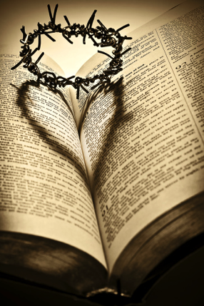
Aklımdan çıkarmam sözünü, Sana karşı günah işlememek için.
Mezmur 119:11

Slide 30
Tek güvencemiz duada ve Allah’ın Söz’ünde. Bunlar, kötüye karşı tek savunmamızdır. Kutsal Kitap’ta Tanrı Söz’üne inanan bazı kadınlar olduğunu biliyor musun?
Notes:
Our only safety is in the Word of God and in prayer. These are our only defenses against the evil one.
Can you think of some Bible women who found the Word of God dependable?

Slide 31
Sara ve Hacer
Yaratılış 21:9-20
Notes:
Grup Çalışması: Ödev # 4
Presenter Not:Grup Yaratılış 21:9-20 okusun. Her iki kadının yerine kendilerini koyarak, o zamandaki yaşadıkları duyguları ve hayatta olan ihtiyaçlarını hayal etmeye çalışsınlar. Sonra aşağıdaki soruları tartışsınlar:
Sara:
1) Ne duygulara sahipti?
2) Onun ihtiyaçları nelerdir?
3) Bugünkü Hıristiyan kadınlar için Sarah'nın deneyimleride ne gibi dersler var?
Hacer:
1) Ne duygulara sahipti?
2) Onun ihtiyaçları nelerdir?
3) Bugünkü Hıristiyan kadınlar için Hacer’in deneyimleride ne gibi dersler var?

Slide 32
Günümüz imanlı kadınları için dört dini ilke
Notes:
From the stories of these two women, I have discovered four Biblical principles for Christian Women today.

Slide 33
1. Allah anlar
Allah hislerimizi, umutlarımızı, korkularımızı ve tüm ihtiyaçlarımızı anlar.
Notes:
1. God understands our feelings, our hopes, our fears, and all our needs.
That encourages me. Jesus notices our tears of loneliness when we have been rejected. He understands our fears when we don't know where the rent for next month is coming from. He understands the fierce temptations Satan sends our way. He knows our weaknesses, our struggles, our problems, and our perplexities.

Slide 34
"Bizim üzüntülerimizden dolayı Tanrı’nın içi burkulur ve bizden onları Kendisine getirmemizi ister. Bize sorun olan her şeyi Tanrı’ya getirebiliriz. Hiçbir şey O’nun için yük olmaz, O tüm evreni yönetendir. Başımıza gelen hiçbir şey O’nun dikkatinden kaçacak kadar küçük değildir. Hayatımızdaki hiçbir şey O’nun anlayamayacağı kadar karanlık ve üzücü olamaz. Hiçbir sorun O’nun çözemeyeceği kadar karmaşık değildir."
Hakikat Yolu ve Hayatımız, S. 75

Slide 35
2. Allah tüm ihtiyaçlarımızı
karşılamak ister:
Allah tüm ihtiyaçlarımızı
karşılamak ister: fiziksel, zihinsel, duygusal, sosyal ve ruhsal.
Notes:
2. God wants to meet all our needs: physical, mental, emotional, social, and spiritual.
He is able to do abundantly above all that we ask or think. He can give a child to a woman in her old age and he can provide water in the desert. He can care for the needs of the single woman such as Hagar or the married woman such as Sarah.

Slide 36
3. Allah’ın Söz’ü güvenilirdir.
Allah’ın Söz’ü güvenilirdir. Yapacağını söylediği şeyi yapar. Onun vaatleri kesindir.

Slide 37
Sara’ya ilerlemiş yaşına rağmen bir oğul sahibi olacağı söylendiğinde gülmüştü. Bu imkânsızdı. Fakat Allah ile her şey mümkündür. O’nun, bizim ihtiyaçlarımızı karşılamak için hiç bilmediğimiz binlerce yolu vardır. Eğer O bir şey yapacağını söylerse yapar. O’nun Söz’üne güvenebiliriz.

Slide 38
Allah ile ilişki, değiştirir: yaşamımızı, görünüşümüzü, geleceğimizi, durumumuzu ve duygularımızı.
4. Allah ile ilişki, değiştirir:

Slide 39
Allah ile ilişki kurduklarında, Sara ve Hacer ile ilgili şeylerin nasıl değiştiğine dikkat ettiniz mi? Yazılı Söz’ündeki Canlı Söz ile buluştuğumuzda her şeyin değişeceği kesindir.

Slide 40
Allah’ın Sözü’ndeki Güç
Direction (Yön)
Emotional Needs (Duygusal İhtiyaçlar)
Physical Needs (Fiziksel İhtiyaçlar)
Eternal Needs (Ebedi İhtiyaçlar)
Need for Meaning (Yaşamın Anlamı için İhtiyaç)
Defense against Satan (Şeytan’a karşı savunma)
Notes:
Bianca Rothchild had every reason to be bitter. In 1939, just before her sixteenth birthday, war broke out in Poland. Six years later, she was the only one left alive from her extended family of 43. All had died in concentration camps.
Bianca suffered much at the hands of her captors: broken ribs, a broken wrist, a mangled leg, and a back damaged when a guard stomped on her with his heavy boots. Today she still wears a brace from that beating.
After the soldier stomped on her, Bianca ran outside during an air raid, looked up at the sky, and cried out, "Oh, God, please let a bomb fall on this camp to put me out of my misery."
When she survived the injuries, she began to wonder what purpose God had for her life. Back inside the barracks, she opened a book and read, "We have a right to the joy of giving so others may receive. We can give material things, and we can give moral support. We can give a friendly ear, and best of all, we can give love."
Bianca realized she had two choices. She could spend the rest of her life feeling sorry for herself, harboring a spirit of hate and bitterness, or she could choose the way of love and kindness, looking away from herself to the needs of others.
That night she made contact with the Living Word. "Dear God," she prayed. "Help me through this terrible ordeal, and I vow to give myself in a true and loving spirit."

Slide 41
Notes:
After the war, she immigrated to the U.S. where she ended up living in a condo. It was there she found a special way to love.
Most of the residents are elderly and often need a little bit of sunshine. Whenever anyone is in the hospital or laid up at home, Bianca sends a cheery get-well card. Each one she signs, "The Sunshine Lady." Over the years dozens of people have received a card from this woman with the sunny temperament.
A neighbor commented, "There's something wrong with her back, but it never seems to have any effect on her happy disposition."
They don't know about her battle with bitterness and despair that night in the concentration camp. They only see the results of her contact with God, the results of her dependence on the Word.
Christina spent the night with Auntie. They spent the evening doing their favorite things. But like most five-year-olds, when it was time for bed she manufactured many reasons to prolong the inevitable.
She had a bath, listened to a story, had a drink, and got up to go to the potty. Next she announced that she was afraid of the dark. So Auntie scurried around to find a night-light.
"Now you can go to sleep," Auntie said, and left the room to attend to other chores. Soon she heard Christina's voice calling her again. "I'm still scared," she said. "Can't you come to bed with me?"
"I can't come to bed now,” Auntie said. "There's too much to do. Anyway, you shouldn't be afraid. We prayed and asked Jesus to send the angels to look after you. Jesus is taking good care of you."
Imagine Auntie's shock and dismay when Christina retorted, "Hmmph! Jesus can't even take care of Himself!"
"What do you mean by that?" Auntie asked.
"Well, He's just a little baby,” Christina explained.
"No, He's not!" Auntie exclaimed.
"Yes, He is,” Christina insisted. "My teacher said so and that He was wrapped in swaddling clothes and lying in a manger."
Auntie quickly assured her that although Jesus was once a baby a long time ago, He is now all grown up, big and strong, and truly able to take care of her.
Christina smiled as the truth dawned on her. "I'm, glad He's big enough," she said.
Ah, yes, Christina, I, too, am glad He's big enough. That which God has promised in His Word, He is big enough to do! You can depend on the Word!

Slide 42
GÜNÜMÜZ İMANLI KADINI İÇİN DÖRT DİNİ İLKE

Slide 43
1. Allah hislerimizi, umutlarımızı, korkularımızı ve tüm ihtiyaçlarımızı anlar. (İbraniler 4:15)
2. Allah tüm ihtiyaçlarımızı karşılamak ister: fiziksel, zihinsel, duygusal, sosyal ve ruhsal. (Flp. 4:19)
3. Allah’ın Söz’ü güvenilirdir. Yapacağını söylediği şeyi yapar. Onun vaatleri kesindir. (Sayılar 23:19)
4. Allah ile ilişki değiştirir: yaşamımızı, görünüşümüzü, geleceğimizi, durumumuzu ve duygularımızı. (Yşa. 61:3)
Notes:
1. God understands our feelings, our hopes, our fears, and all our needs. (Hebrews 4:15)
“His heart of love is touched by our sorrows and even by our utterances of them. Nothing that in any way concerns our peace is too small for Him to notice. There is no chapter of our experience too dark for Him to read. No calamity can befall the least of His children, no anxiety harass the soul, no joy cheer, no sincere prayer escape the lips, of which our heavenly Father is unobservant, or in which He takes no immediate interest.” Steps to Christ, p. 100.
2. God wants to meet all our needs: physical, mental, emotional, social, and spiritual. (Philippians 4:19)
“He bids them seek first the kingdom of God and His righteousness, and His promise is that all things needful to them for this life shall be added. Worry is blind, and cannot discern the future; but Jesus sees the end from the beginning. In every difficulty He has His way prepared to bring relief. Our heavenly Father has a thousand ways to provide for us, of which we know nothing.” Desire of Ages, p. 330.

Slide 44
Notes:
3. God’s Word is dependable. He will do what He says He will do. His promises are sure. (Numbers 23:19)
“The assurance is broad and unlimited, and He is faithful who has promised. When we do not receive the very things we ask for, at the time we ask, we are still to believe that the Lord hears and that He will answer our prayers.....When our prayers seem not to be answered, we are to cling to the promise; for the time of answering will surely come, and we shall receive the blessing we need most. But to claim that prayer will always be answered in the very way and for the particular things that we desire, is presumption. God is too wise to err, and too good to withhold any good thing from them that walk uprightly. Then do not fear to trust Him, even though you do not see the immediate answer to your prayers. Rely upon His sure promise, ‘Ask and it shall be given you.’” Steps to Christ, p. 96.
4. Contact with God transforms: our lives, our outlook, our future, our circumstances, and our emotions. (Isaiah 61:3)
Did you notice how things changed for Sarah and Hagar when they made contact with God? It is always true, when we meet the Living Word in His Written Word.

Slide 45

Dua Eden Kadın

